Slide 1
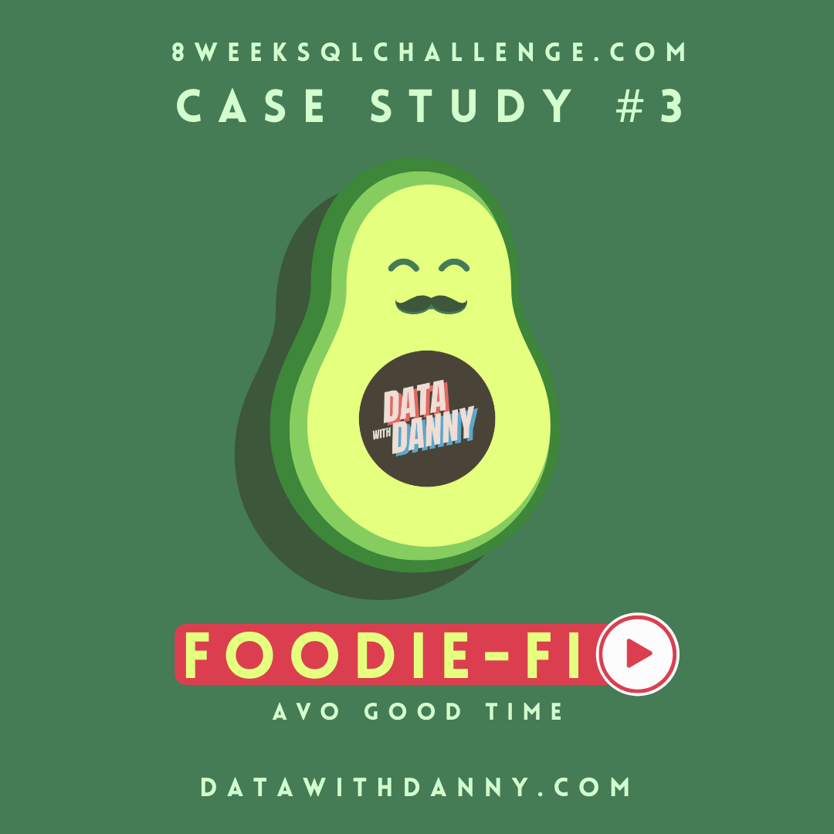
Danny Ma Case Study 3: Foodie-Fi
By : Shikhar Chopra
Tool used – Microsoft SQL Server

Slide 2
Introduction
Subscription based businesses are super popular and Danny realised that there was a large gap in the market - he wanted to create a new streaming service that only had food related content - something like Netflix but with only cooking shows!
Danny finds a few smart friends to launch his new startup Foodie-Fi in 2020 and started selling monthly and annual subscriptions, giving their customers unlimited on-demand access to exclusive food videos from around the world!
Danny created Foodie-Fi with a data driven mindset and wanted to ensure all future investment decisions and new features were decided using data. This case study focuses on using subscription style digital data to answer important business questions.

Slide 3
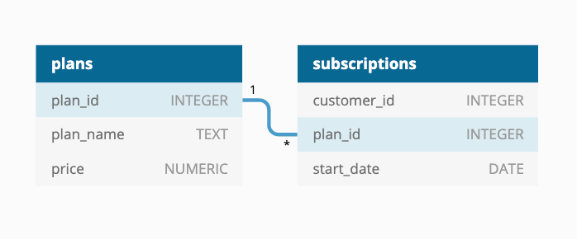
Available Data
Danny has shared the data design for Foodie-Fi and also short descriptions on each of the database tables - our case study focuses on only 2 tables but there will be a challenge to create a new table for the Foodie-Fi team.

Slide 4
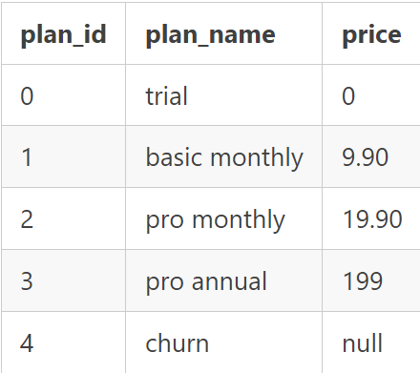
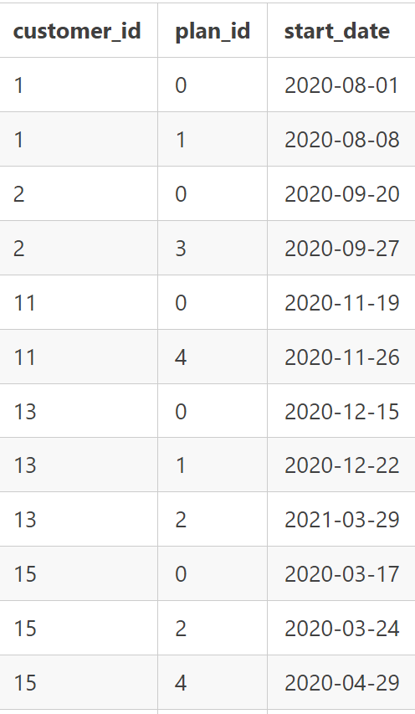
Tables
Table 1: plans
Table 2: subscriptions

Slide 5
Case Study Questions

Slide 6

Q1. How many customers has Foodie-Fi ever had?

Slide 7
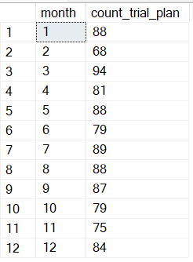
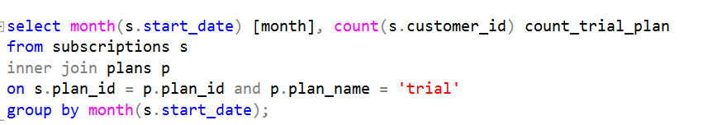
Q2. What is the monthly distribution of trial plan start_date values for our dataset

Slide 8
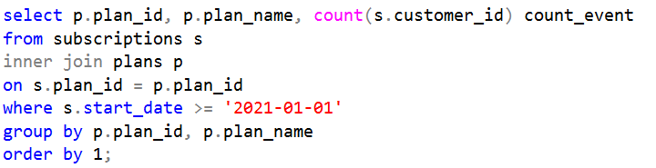
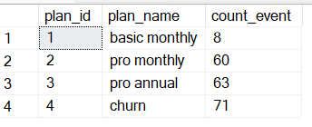
Q3. What plan start_date values occur after the year 2020 for our dataset? Show the breakdown by count of events for each plan_name

Slide 9
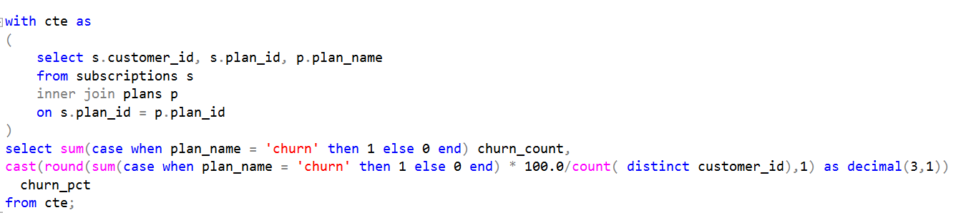

Q4. What is the customer count and percentage of customers who have churned rounded to 1 decimal place?

Slide 10
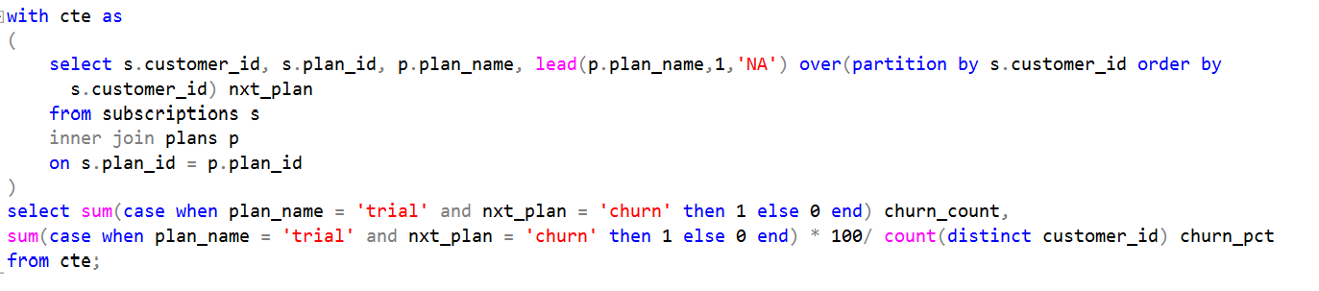

Q5. How many customers have churned straight after their initial free trial - what percentage is this rounded to the nearest whole number?

Slide 11
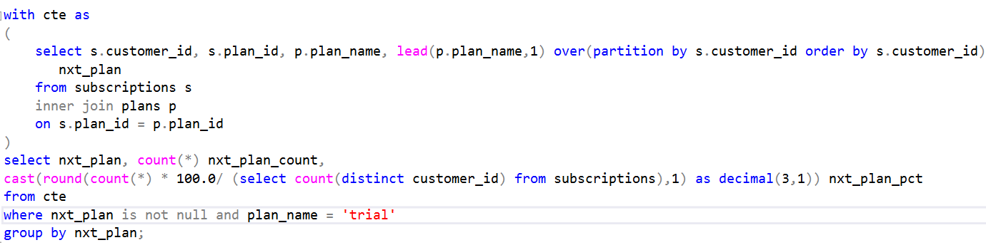
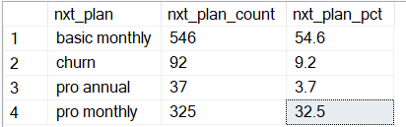
Q6. What is the number and percentage of customer plans after their initial free trial?

Slide 12
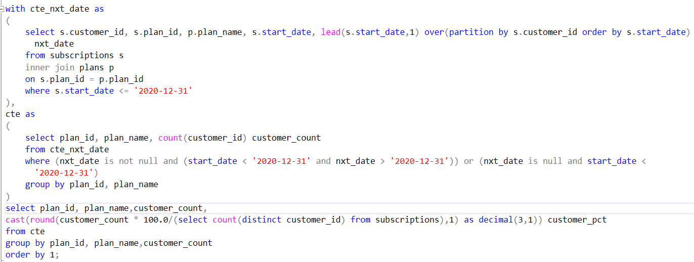
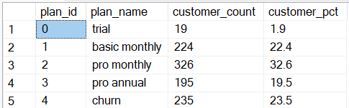
Q7. What is the customer count and percentage breakdown of all 5 plan_name values at 2020-12-31?

Slide 13
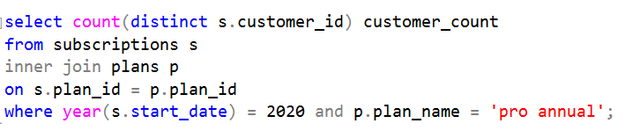

Q8. How many customers have upgraded to an annual plan in 2020?

Slide 14
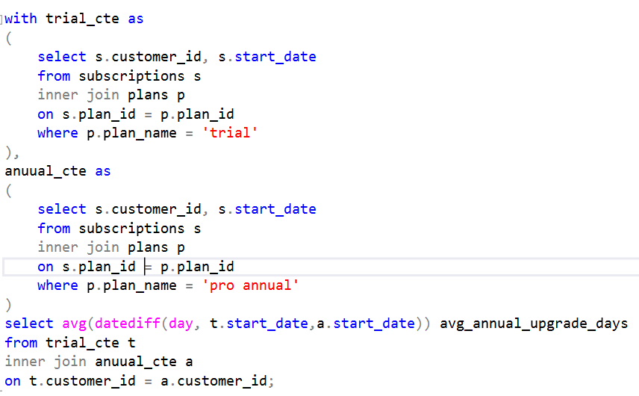

Q9. How many days on average does it take for a customer to an annual plan from the day they join Foodie-Fi?

Slide 15
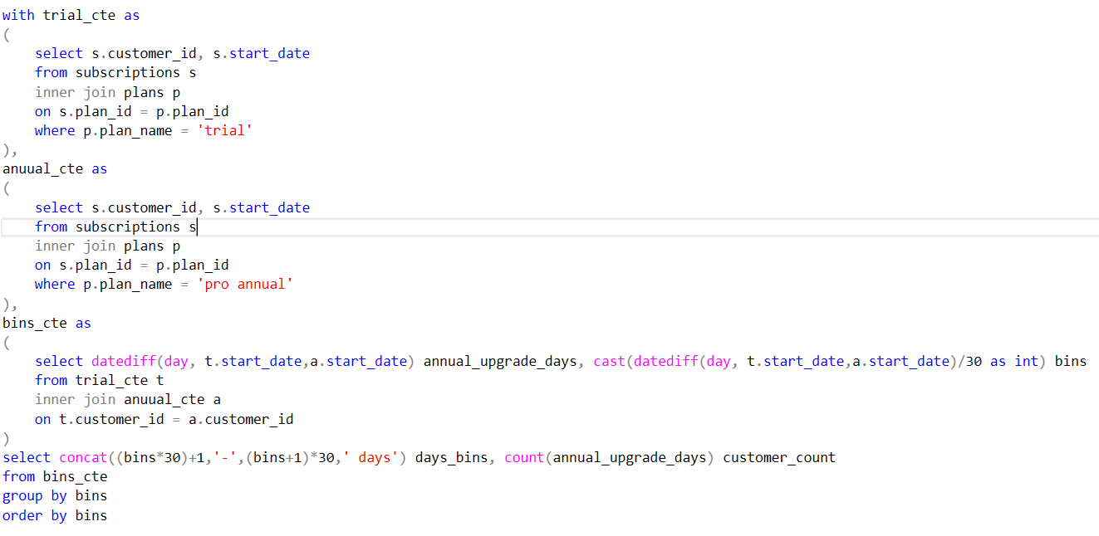
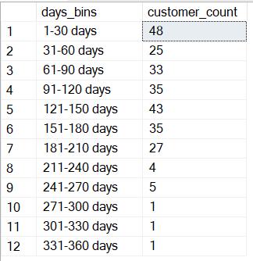
Q10. Can you further breakdown this average value into 30 day periods (i.e. 0-30 days, 31-60 days etc)?

Slide 16
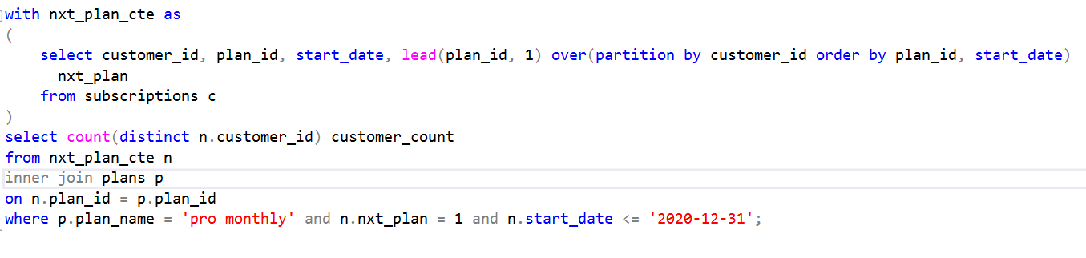

Q11. How many customers downgraded from a pro monthly to a basic monthly plan in 2020?

